Slide 1
Office 2016 for Mac Deployment & Updates
Paul Bowden
Apple Platform Experience
Microsoft Corporation
pbowden@microsoft.com

Slide 2
Agenda
Overview of deployment packages and techniques
Deployment supportability
Update techniques and MAU
References
Q&A

Slide 3
Deployment Packages – ‘SKUless’ PKGs
Suite Installer
Standalone Installers
Mac AppStore
Download links at http://macadmins.software
Packages can be used for any license type
Customize install behavior through choices XML

Slide 4
Deployment Packages – Volume License
Suite VL Installer
Standalone VL Installers
Download from VLSC in ISO format
Automatic serialization for VL
VL Serializer also supplied in Suite VL .iso

Slide 5
VL Serializer
New package starting with 15.17 release
Uses:
1. Serialize a SKUless install as VL
2. Regenerate VL license plist
The PKG auto-runs the ‘Microsoft Office Setup Assistant’ which uses a hardware ID to generate the volume license file /Library/Preferences/com.microsoft.office.licensingV2.plist

Slide 6
‘Slim’ Suite Installer
1.3 GB
902 MB
751 MB
684 MB
594 MB
375 MB
Word | Excel | PowerPoint | Outlook | OneNote
App Binary | App Binary | App Binary | App Binary | App Binary
UI Resources | UI Resources | UI Resources | UI Resources | UI Resources
Frameworks | Frameworks | Frameworks | Frameworks | Frameworks
Fonts | Fonts | Fonts | Fonts | Fonts
Proofing Tools | Proofing Tools | Proofing Tools | Proofing Tools | Proofing Tools
Code Signature | Code Signature | Code Signature | Code Signature | Code Signature
….. | ….. | ….. | ….. | …..

Slide 7
Supported Deployment Techniques
Manual install
SSH, Apple Remote Desktop
Casper, Munki, AutoPKG, AutoDMG
Microsoft works closely with the MacAdmins community to validate third-party deployment solutions, and address issues
http://macadmins.org

Slide 8
Non-supported techniques!
Copying the licensing plist between computers
Reason: Current lazy validation check will get much more aggressive in a future update
Using an ‘updater’ package for an initial install
Reason: The Licensing Helper will not get installed
Moral: Just because it ‘seems to work’ now doesn’t mean that it will continue working in the future.

Slide 9
Monthly Update and Engineering Cycle
Work, work, work
Fork the code == Last Sunday in the month
Validate end to end, test, stabilize
Fork + 7 days == Provide build to Office Insiders
Inspect crash telemetry and final fit and finish
Fork + 14 days == Release final build

Slide 10
Staying up-to-date with monthly releases
Expect regular updates in the second week of every month (not necessarily ‘patch Tuesday’)
MAU is the recommended update vehicle
Up until now, all monthly updates were ‘combo’ apps
Starting next month, we will ship ‘delta’ updates in addition to ‘combo’ updates

Slide 11
Delta vs. Combo Updaters
+
= 15.19
App Update | Combo (MB) | Delta (MB)
Word | 902 | 184
Excel | 799 | 163
PowerPoint | 751 | 148
Outlook | 594 | 171
OneNote | 375 | 114
TOTAL | ~ 3 GB | 780 MB
15.12
Base
15.19
Combo
+
= 15.19
15.18
Base
15.19
Delta
Delta sizes are based on N-1 version support
MAU will determine which update type to surface

Slide 12
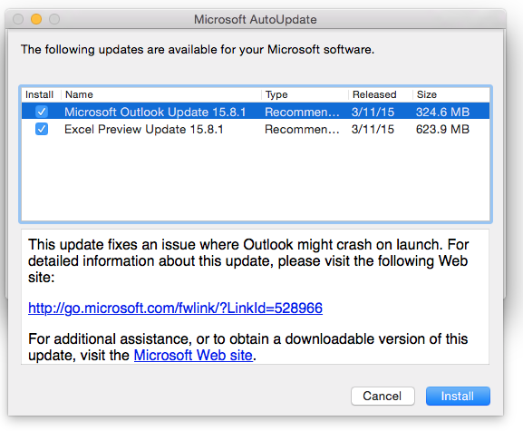
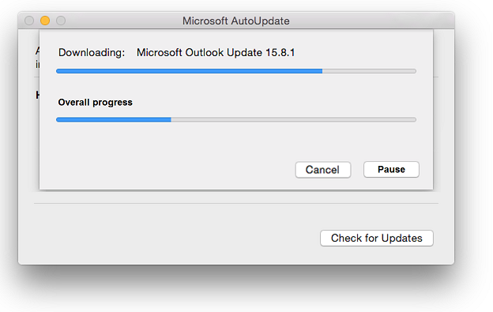
Microsoft AutoUpdate (MAU)
Used for updating non-Mac AppStore Office apps
Major changes in 2016
Downloads per-app updates rather than suite
Silent install capabilities
Pause/Resume download
Support for multiple channels
Support for custom channel

Slide 13
Living in a world without MAU
You are responsible for pushing update notifications and packages to users
Figure out the most efficient strategy for your org. E.g
Always push combo updates
Use the latest Suite Installer as an upgrade

Slide 14
References
MacAdmin Slack Community
http://macadmins.org
Office Software Download Links
http://macadmins.software
Clayton Burlison’s Awesome Write-Up
https://clburlison.com/demystify-office2016/

Slide 15
Q&A

